Slide 1

56th World Continuous Auditing & Reporting Symposium
April 27-28, 2023, Madrid, Spain
Auditing Proof of Reserves in Crypto Exchange:
Issues, Challenges & Way Forward
Presented by : Vinod Kashyap & Simran Diwedi

Slide 2
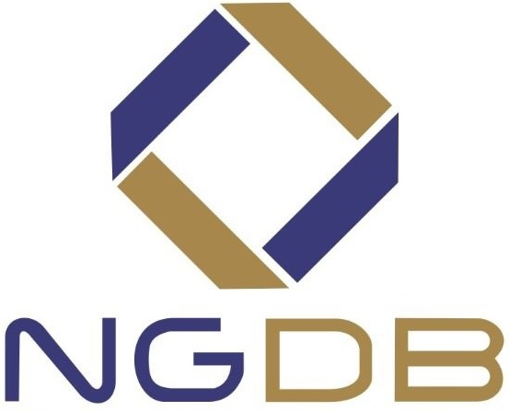
Outline
Preamble
Proof of Reserves
Issues & Challenges
Auditing Standards & Guidance
Way Forward
Q & A
2
4/28/2023
56th World Continuous Auditing & Reporting Symposium

Slide 3
Preamble
3
4/28/2023
56th World Continuous Auditing & Reporting Symposium

Slide 4
Crypto Jargon
Cryptocurrency Exchange
Cryptocurrency exchanges are privately –owned platforms that facilitate the trading of cryptocurrencies for other crypto assets , including digital and fiat currencies and NFTs.
Proof of Reserves
Proof of Reserves (PoR) is an independent audit conducted by a third party which seeks to ensure that a custodian holds the assets it claims to on behalf of its clients. This auditor takes an anonymized snapshot of all balances held and aggregates them into a Merkle Tree - a privacy-friendly data structure that encapsulates all client balances.
The idea behind publication of Proof of Reserves to the public and in particular the customers of crypto exchange is that cryptocurrency held on deposit matches up with users balances.
Proof of Liabilities
Proof of Liabilities (PoL) is a scheme designed to let companies that accept monetary deposits from consumers (e.g. Bitcoin exchanges, gambling websites, online Bitcoin wallets, etc.) prove their total amount of deposits (their liabilities) without compromising the privacy of individual users.
Proof of Solvency
Proof of Solvency = Proof of Reserves + Proof of Liabilities
4
4/28/2023
56th World Continuous Auditing & Reporting Symposium

Slide 5
Crypto Jargon Cont..
Merkel Tree
In cryptography or computer science, a hash tree or Merkle tree is a tree in which every "leaf" (node) is labelled with the cryptographic hash of a data block, and every node that is not a leaf (called a branch, inner node, or innode) is labelled with the cryptographic hash of the labels of its child nodes. A hash tree allows efficient and secure verification of the contents of a large data structure.
5
4/28/2023
56th World Continuous Auditing & Reporting Symposium

Slide 6

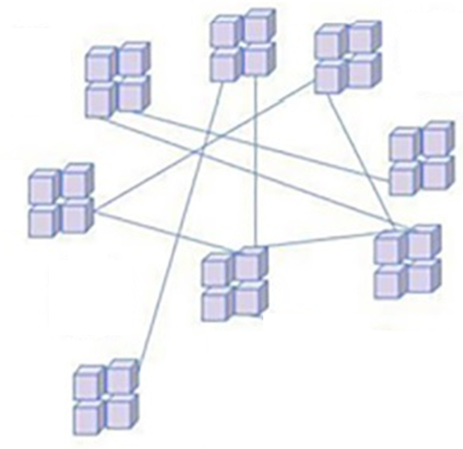
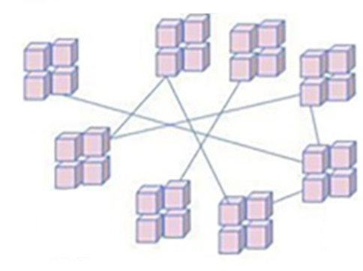
Types of Crypto Exchanges
CEX
DEX
Sellers
Bank Account Linkage
KYC & Account Creation
BTC wallet
Crypto & INR withdrawal
Trading Engine
DEX Smart Contract
Liquidity Management
Open Order Book
Liquidity Providers
Automated Market Maker
Blockchain & INR wallet creation
Crypto & INR deposits
Bank Account Linkage
KYC & Account Creation
ETH wallet
Buyers
6
4/28/2023
56th World Continuous Auditing & Reporting Symposium

Slide 7
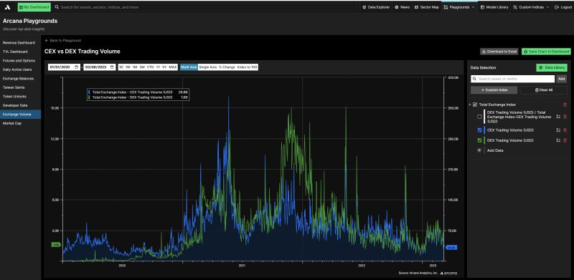
CEX Vs. DEX
Centralized Exchange (CEX) aggregated trading volume in blue (right hand side axis)
Decentralized Exchange (DEX) aggregated trading volume in green (Left hand side axis)
CEX are 95%% of aggregated trading volume and DEX are only 5%
The largest exchanges are still CEX
7
4/28/2023
56th World Continuous Auditing & Reporting Symposium

Slide 8
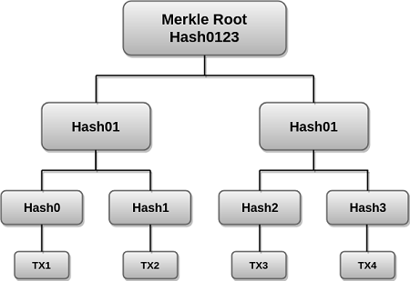
Merkel Tree
In cryptography or computer science, a hash tree or Merkle tree is a tree in which every "leaf" (node) is labelled with the cryptographic hash of a data block, and every node that is not a leaf (called a branch, inner node, or innode) is labelled with the cryptographic hash of the labels of its child nodes. A hash tree allows efficient and secure verification of the contents of a large data structure.
It is a mathematical data structure composed of hashes of different blocks of data, and which serves as a summary of all the transactions in a block. It also allows for efficient and secure verification of content in a large body of data. It also helps to verify the consistency and content of the data. Both Bitcoin and Ethereum use Merkle Trees structure. Merkle Tree is also known as Hash Tree.
8
4/28/2023
56th World Continuous Auditing & Reporting Symposium

Slide 9
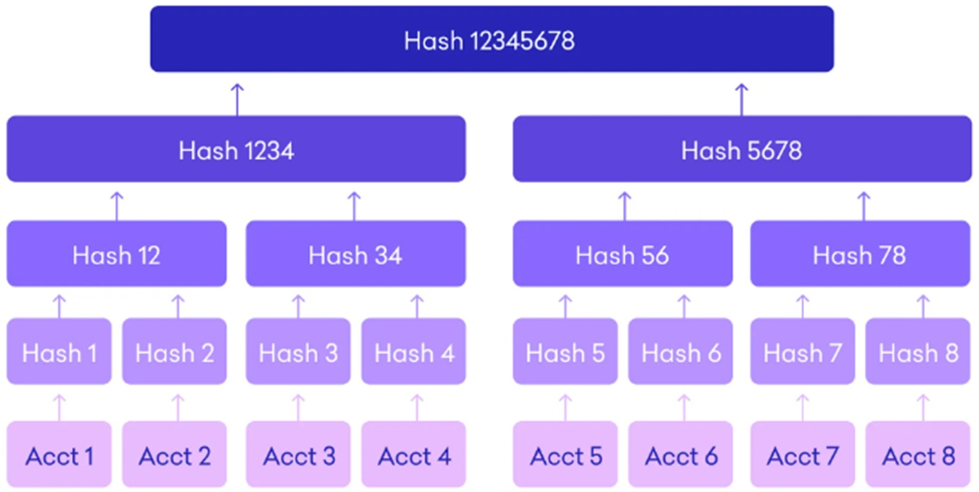
Auditing Proof of Reserves on Merkel Tree
The data of all the balances held is taken by the third party in the form of a Merkle tree
A Merkle root is then obtained, which uniquely identifies and sums up the balances of all the accounts taken
These balances are then verified on public blockchains where assets are held using the digital signatures provided by the exchange
The data of the balances and the details of the assets on the public blockchains are verified. These numbers should balance, thus ensuring consistency
Systems will also be set up for customers to check if the assets they hold are verified
Any changes in data will affect the Merkel root indicating possible tampering with assets
9
4/28/2023
56th World Continuous Auditing & Reporting Symposium

Slide 10

Crypto Exchange & Investors
Investors use exchange to trade dollars for crypto
Investors have little to no assurance over reserves custody
Audit methods, formal report, investors participate in proving reserves
10
4/28/2023
56th World Continuous Auditing & Reporting Symposium

Slide 11
Proof of Reserves
11
4/28/2023
56th World Continuous Auditing & Reporting Symposium

Slide 12
Proof-of-Reserves
Proof of reserves is supposed to instill some added trust, but they aren’t complete audits and don’t necessarily provide a full picture of a company’s financials, such as total liabilities (deposits) owed back to clients and other types of debt. Nor do they assess the quality of a crypto exchange’s controls.
12
4/28/2023
56th World Continuous Auditing & Reporting Symposium

Slide 13
Audit Reports on Proof of Reserves
Crypto Exchange
Binance Capital Management Co Ltd. – Agreed Upon Procedures (AUP) Report under ISRS 4400 by Mazaras
FTX Trading Ltd. – Attestation report not available. Prager Metis LLP & Armanino LLP provided clean audit opinions as on December 31, 2021 and 2020.
CoinDCX – Auditors Certificate under Guidance Note issued by ICAI by SGCO & Co. LLP
CoinSwitch – Agreed Upon Procedures (AUP) Report under SRS 4400 by ICAI (Corresponding to ISRS 4400 issued by IAASB) by INMAC Management Services Ltd.
13
4/28/2023
56th World Continuous Auditing & Reporting Symposium

Slide 14
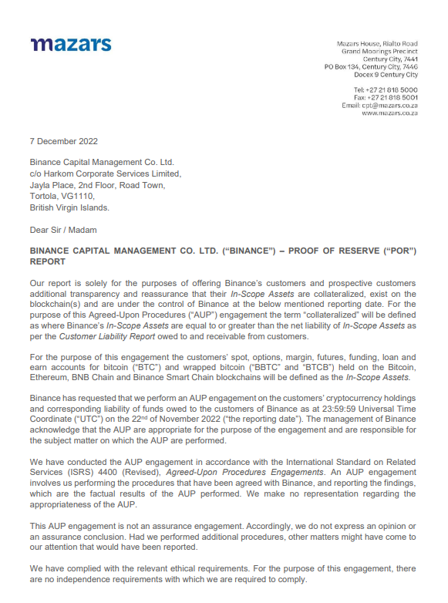
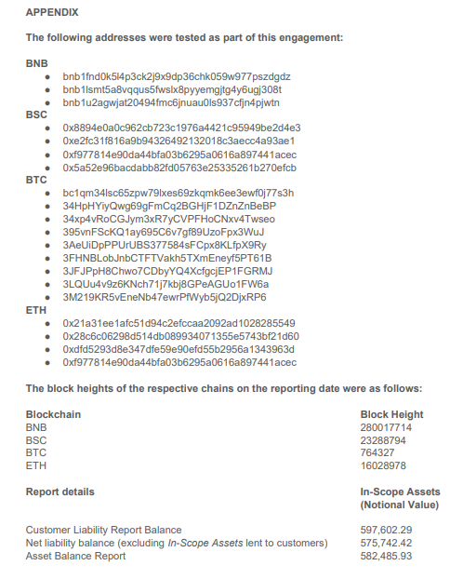

Binance
Facts
Agreed Upon Procedures (AUP)Report under ISRS 4400 issued by IAASB
Obtained “Assets Balance Reports” and “Public Key Addresses” from Management and verified the same.
Verified movement of funds at “Public Key Addresses” using Private Key
Obtained “Customer Liability Report” from the database
Checked completeness of data and for any duplicate customer Ids
Red Flags
Limitations of an Agreed Upon Procedures (AUP) Report
Exchange financial position
Existence & effectiveness of internal controls
Binance Accounts have never been audited
14
4/28/2023
56th World Continuous Auditing & Reporting Symposium

Slide 15
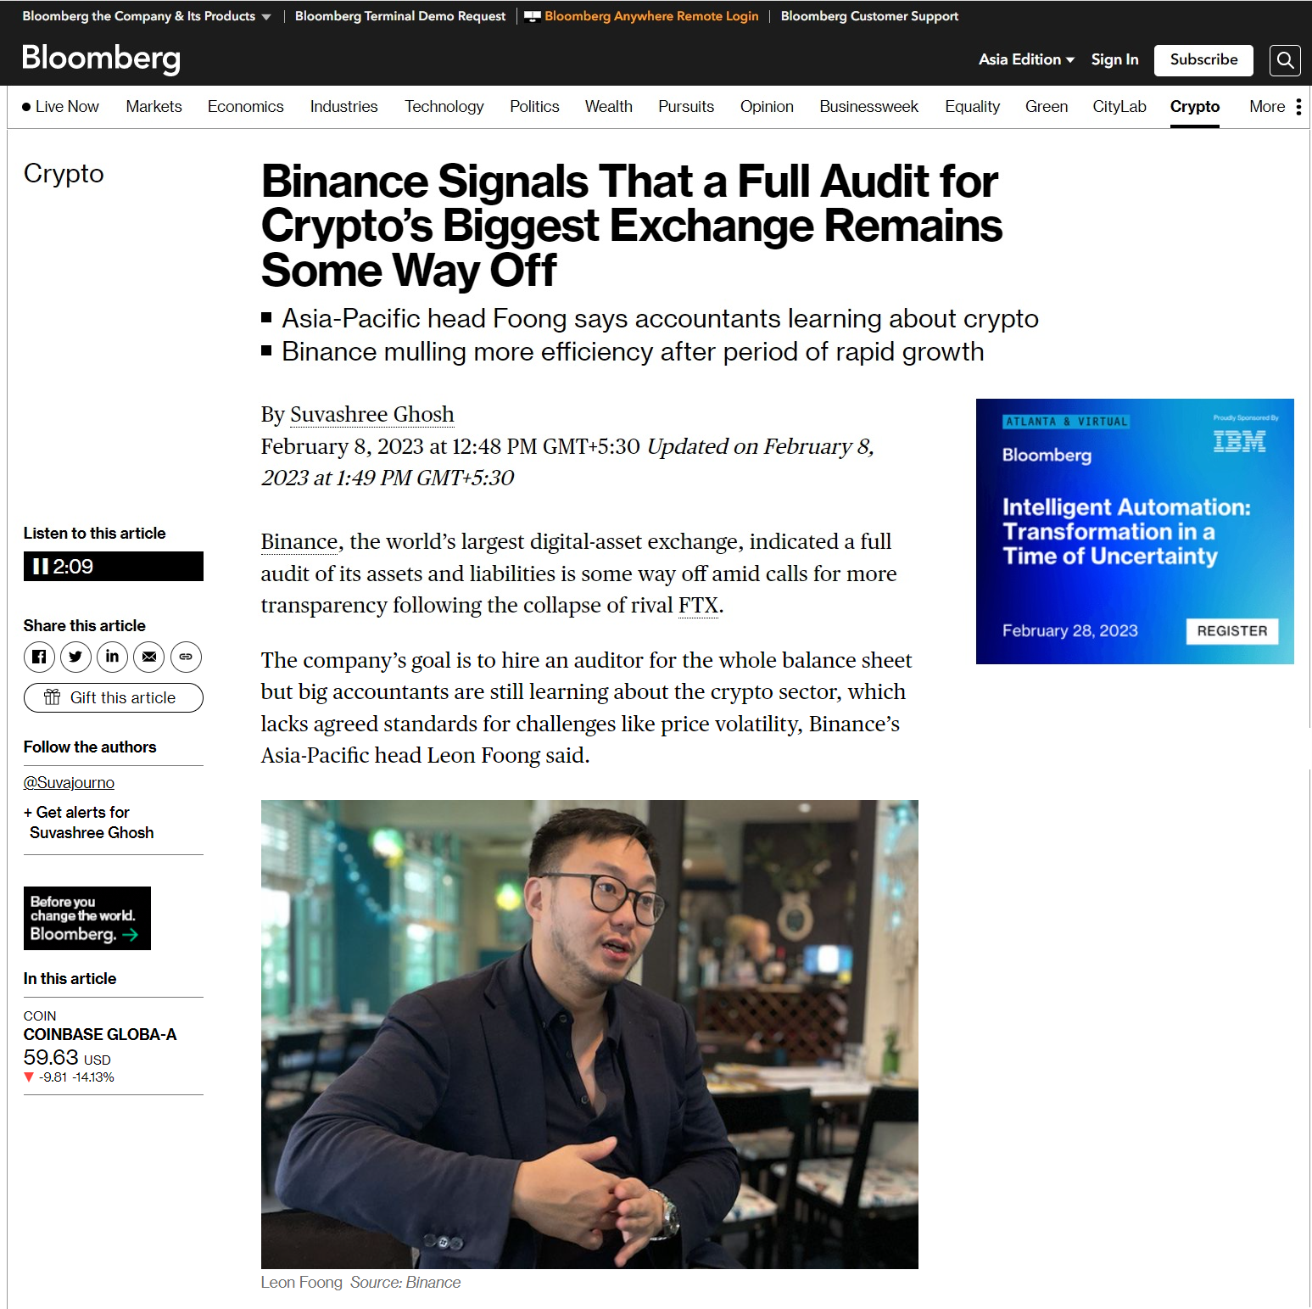
Binance Cont..
More skeletons may come out of the cupboard when audit is done…
15
4/28/2023
56th World Continuous Auditing & Reporting Symposium

Slide 16
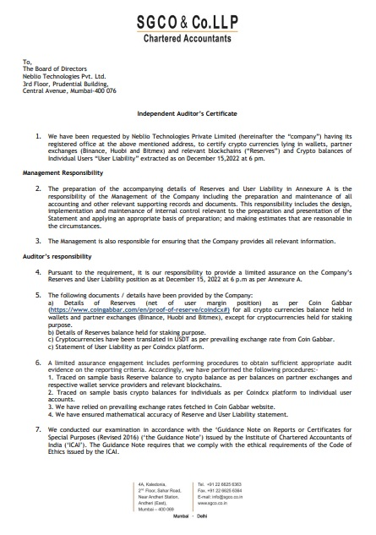
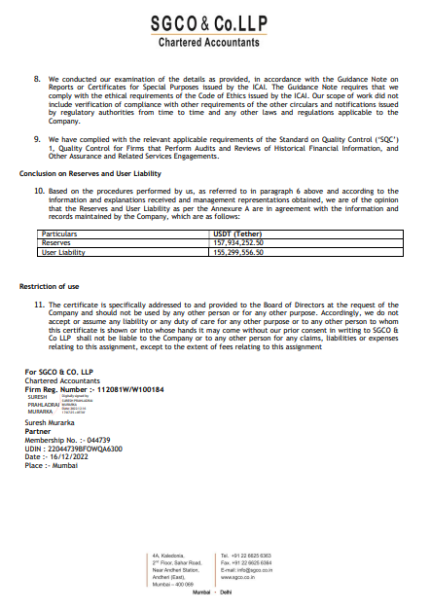
CoinDCX
Facts
Independent Auditors Certificate on Proof of Reserves and Customer Liability in accordance with ICAI Guidance Note on Reports or Certificates for Special Purpose.
ICAI Guidance Note is based on ISAE 3000 “Assurance Engagements Other than Audits or Reviews of Historical Financial Information” issued by IAASB.
Red Flags
ISAE 3000 may not be suitable for providing assurance on Proof of Reserves.
The use of statistical sampling techniques in a small population of data (reserve balances) could lead to misleading results.
16
4/28/2023
56th World Continuous Auditing & Reporting Symposium

Slide 17
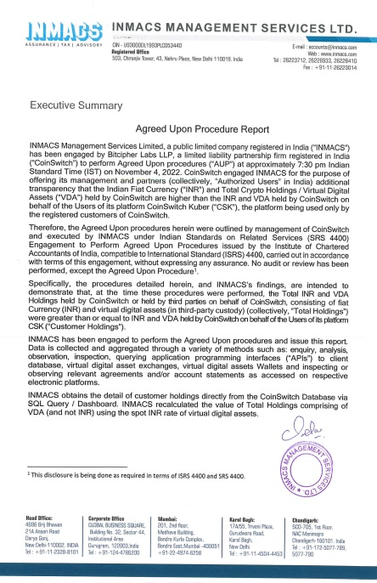
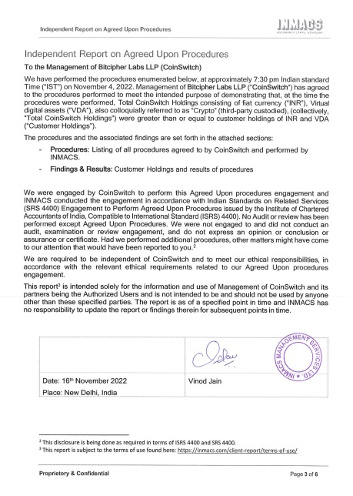
CoinSwitch
Facts
Agreed Upon Procedures (AUP) Report on Proof of Reserves and Customer Liability in accordance with Indian Auditing Standards – SRS 4400 “Engagement to Perform Agreed Upon Procedures” issued by ICAI.
Obtained a list of customer holding with Coin Switch from the database
Compared the customer holding at the wallet address on public blockchain
Applied the INR rate for each coin from Nomics portal.
Red Flags
How ethical is it for a Practitioner to issue an Agreed Upon Procedures (AUP) Report on Proof of Reserves in a Management Consultancy company instead of issuing the same in the accounting firm ?
17
4/28/2023
56th World Continuous Auditing & Reporting Symposium

Slide 18
Audit Reports on Proof-of-Reserves
Stable Coins
Teether Holdings Limited - Audit Report of Consolidated Reserves under ISAE 3000 by BDO
Circle Internet Financial Inc. - Attestation Report on Reserves Account under auditing standards issued by AICPA
NEXO - Real Time Assurance Report by Armanino
Techteyx Ltd. (TrueUSD) – Attestation report on TrueUSD holding under auditing standards issued by AICPA by Armanino
18
4/28/2023
56th World Continuous Auditing & Reporting Symposium

Slide 19
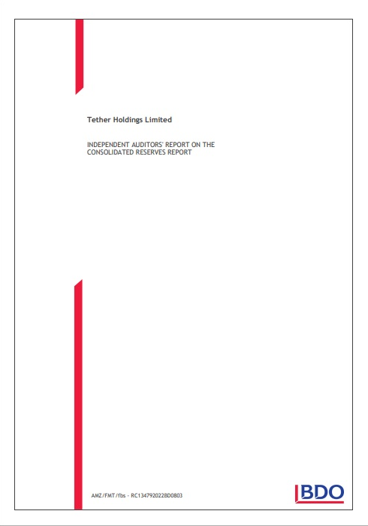
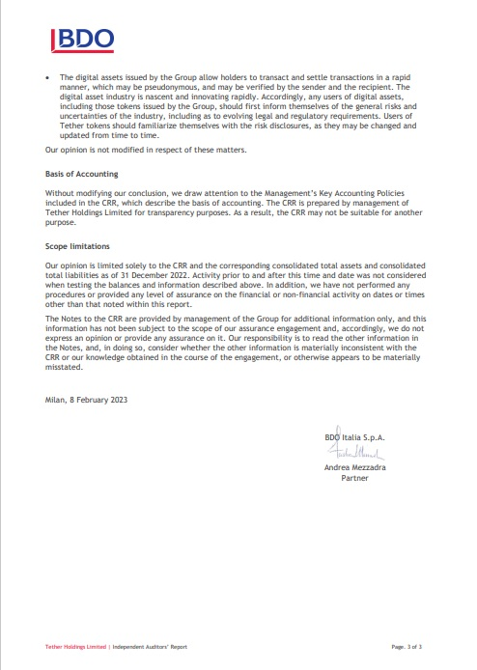
Teether Holdings Limited.
Facts
Teether (USDT) has the largest market capitalization among fiat-backed Stablecoins
Central Banks don’t have any technical solution of monitoring liabilities of fiat-backed Stablecoins and the assets that back them
Teether issues audit report on its consolidated reserve account to show that it’s liabilities are 100% covered by its reserves and assets
Teether shared Audit Report on Consolidated Reserve Account in accordance with ISAE 3000. (Revised). – “Assurance Engagements Other than Audit and Review of Historical Financial Information” issued by IAASB.
Red Flags
Audit Report is based upon Consolidated Reserves Account prepared by the management NOT extracted from an audited financial statement
Teether has never published its audited financial statements in the last 5 years triggering existential fears over the $68 Bn Stablecoins dependability and bonafide.
ISAE 3000 may not be suitable for audit of Consolidated Reserves.
19
4/28/2023
56th World Continuous Auditing & Reporting Symposium

Slide 20
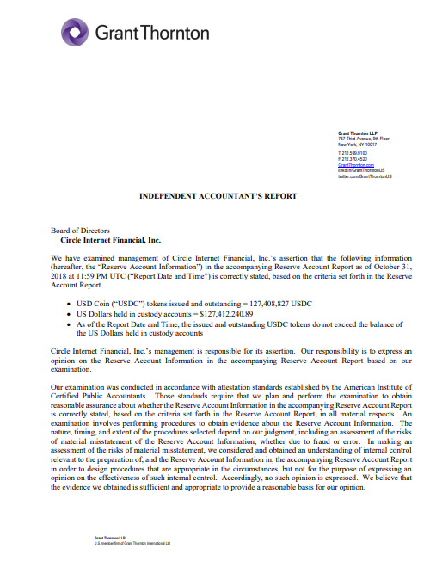
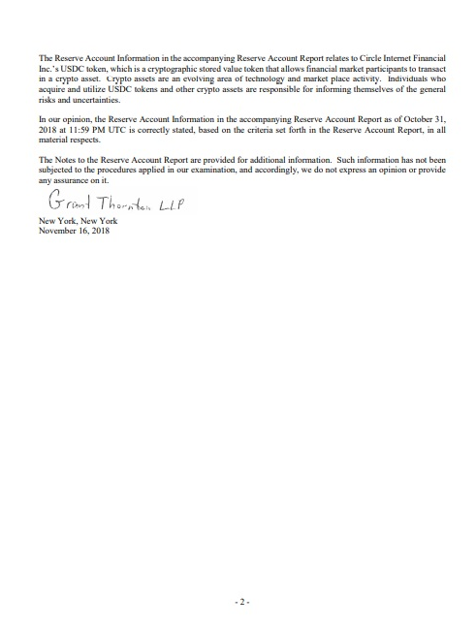
Circle Internet Financial Inc.
Facts
Attestation Report on Reserve Account in accordance with Attestation Standards issued by AICPA.
The Practitioners used the words “correctly stated” in expression of opinion in their reports for the months from October 2018 to December 2021.
Red Flags
The use of words “correctly stated” amounts to providing “Absolute Assurance” on Reserve Account.
“Absolute Assurance is not attainable because of the nature of audit evidence and characteristics of the fraud” – AICPA SAS No 82
AICPA suggests the use of words “fairly stated” in expression of opinion – SSAE 18
20
4/28/2023
56th World Continuous Auditing & Reporting Symposium

Slide 21
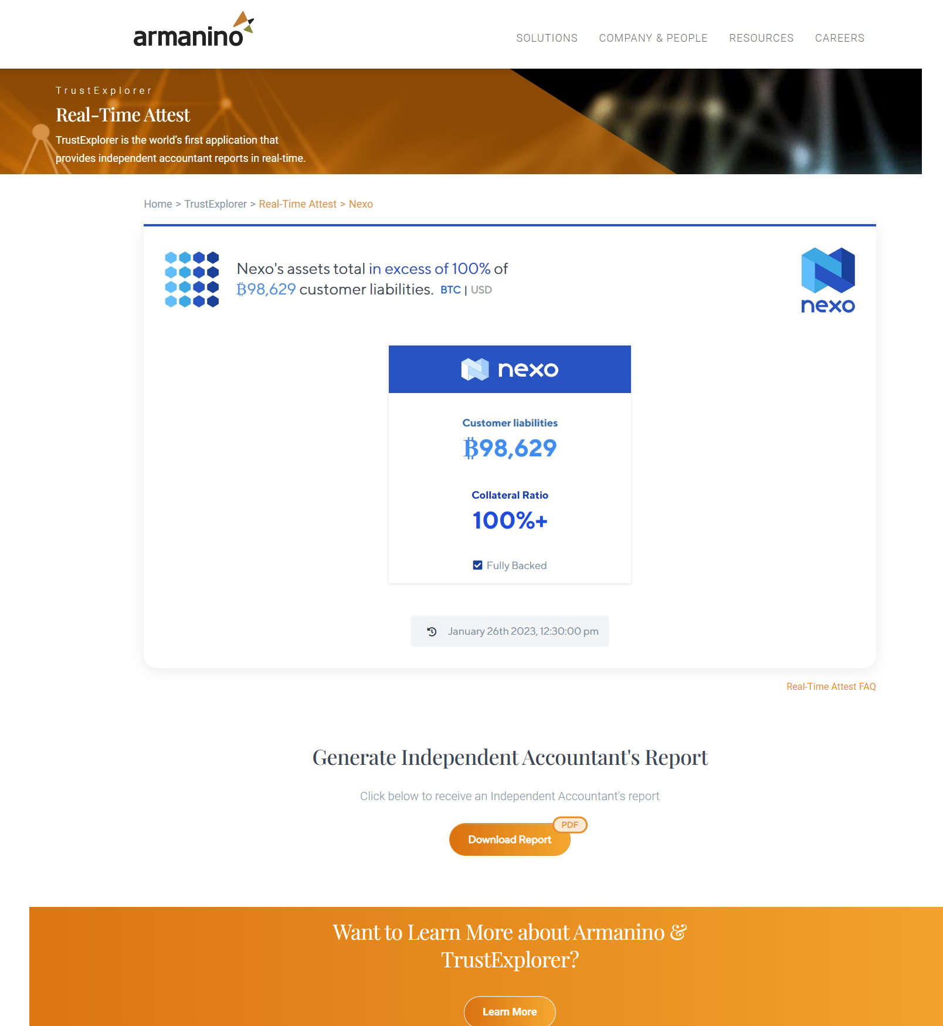
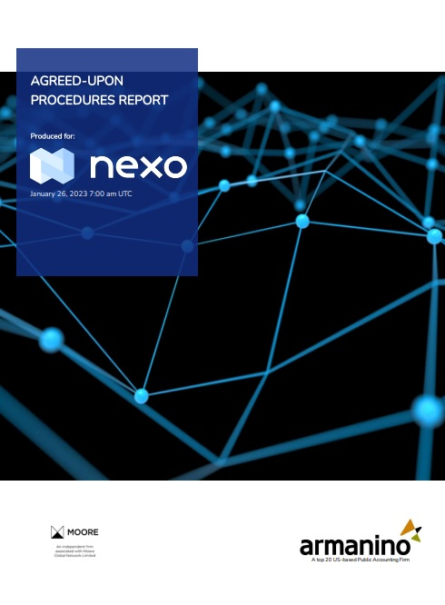
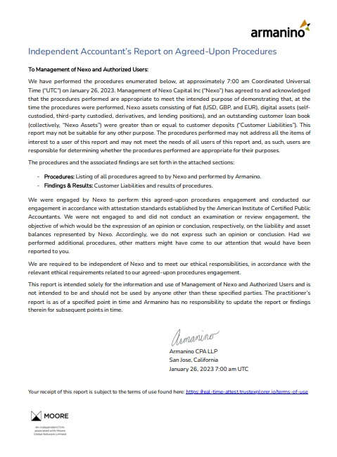
NEXO
21
4/28/2023
56th World Continuous Auditing & Reporting Symposium

Slide 22
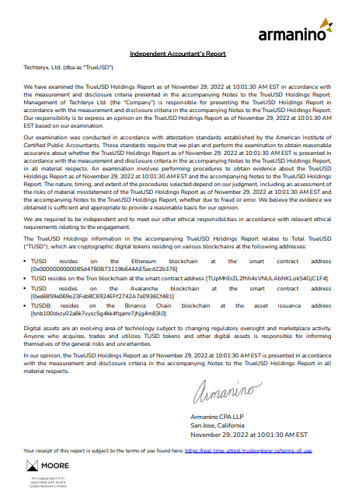
TrueUSD
Facts
Independent Accountant’s Report on TrueUSD Holdings report in accordance with Attestation Standards issued by AICPA.
Red Flags
Report generated by computer system without any involvement of the Practitioner in the audit process.
22
4/28/2023
56th World Continuous Auditing & Reporting Symposium

Slide 23
Issues & Challenges
23
4/28/2023
56th World Continuous Auditing & Reporting Symposium

Slide 24




What could go wrong?
2
4
Crypto Exchange may have material contingent liability.
Crypto Exchange may not have exclusive control over the Private Keys.
1
3
Crypto Exchange may have material liabilities other than “outstanding balance due to it’s customers.
Crypto Exchange may have material off-chain assets or real world assets.
24
4/28/2023
56th World Continuous Auditing & Reporting Symposium

Slide 25
Issues & Challenges Cont..
6
8
Crypto Exchange may manipulate the facts since the correctness of verified balances is only valid during the time of audit.
Crypto exchange could borrow funds to show it’s reserves are in excess of liabilities.
5
7
A fraudulent audit result may be produced by a third party auditor in collaboration with the custodian under consideration.
The legitimacy of audit can be impacted by the loss of Private Keys or users funds.
25
4/28/2023
56th World Continuous Auditing & Reporting Symposium

Slide 26
Issues & Challenges Cont..
10
12
Crypto Exchange might be involved in shadow banking.
Crypto exchange may not have strong finances
9
11
Correctness of audit of Proof of Reserves depends upon the auditors competence.
Internal Controls may not be effective in crypto exchange
26
4/28/2023
56th World Continuous Auditing & Reporting Symposium

Slide 27
Auditing Standards & Guidance
27
4/28/2023
56th World Continuous Auditing & Reporting Symposium

Slide 28
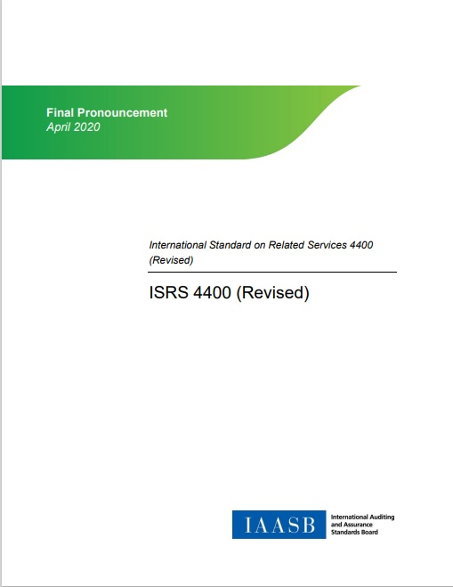
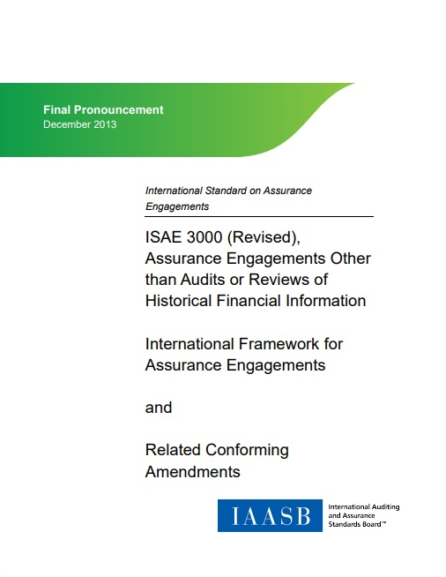
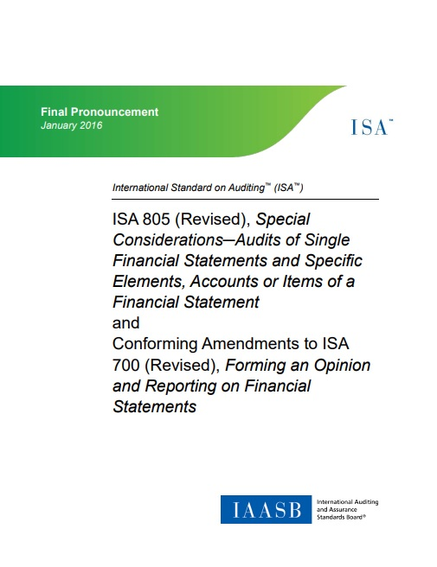
Auditing Standards
Agreed Upon Procedures Engagements
Assurance Engagements Other than Audits or Reviews of Historical Financial Information
Special Considerations – Audit of Single Financial Statements and Specific Elements, Accounts or Items of a Financial Statement
28
4/28/2023
56th World Continuous Auditing & Reporting Symposium

Slide 29
Guidance
ISO/TC 307/AHG 2 “Guidance on Auditing DLT Systems” may consider developing guidance on auditing Proof of Reserves.
AICPA - Proof of Reserves Working Group is developing guidance on audit of Proof of Reserves
No Guidance
56th World Continuous Auditing & Reporting Symposium
29
4/28/2023

Slide 30
Way Forward
56th World Continuous Auditing & Reporting Symposium
30
4/28/2023

Slide 31
Approach to Auditing Proof of Reserves
02
04
06
Evaluation of Internal Controls
Verification of on-chain & off-chain assets
Compliance with ISA 805
Auditor should evaluate the internal controls implemented by the crypto exchange to address the related risks.
Auditor should verify both on-chain and off-chain assets appearing in the financial statement of crypto exchange.
Audit should comply with the requirements of ISA 805 (Revised) “Special Considerations – Audit of Single Financial Statements and Specific Elements, Accounts, or Items of a Financial Statement.
01
03
05
Risk Assessment
Complete Financial Statement Audit
Exclusive Control Over Private Keys
Auditor should make a risk assessment of crypto exchange as per risk assessment framework followed in the country. Viz: COSO -2013 Framework, ISA 315 , Turnboil in UK etc.
Auditor should audit the complete financial statement of crypto exchange and not just on-chain assets and customers liabilities.
Auditor should verify if the crypto exchange has exclusive control over the Private Keys relating to on-chain crypto assets.
31
4/28/2023
56th World Continuous Auditing & Reporting Symposium

Slide 32
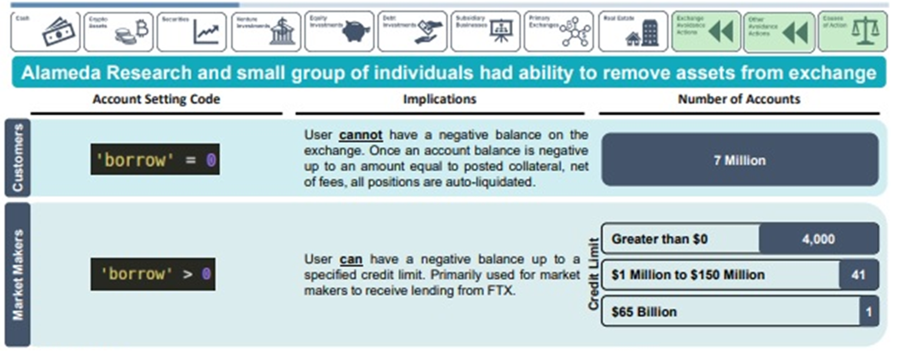
Risk Assessment: Crypto Shadow Banking
Source: FTX Bankruptcy Case filings
Crypto Industry’s behind the curtain activity poses a huge challenge to the auditors.
Bankruptcy documents of FTX provide an insight into the secretive activities of crypto world
Among 7 million users of FTX, 41 were allowed to run into a negative balance up to 150 $ Mn and 1 was allowed a negative balance up to $65 Bn before the exchange would ask to settle the account.
Such an exemption to some privileged users will put other customers funds at risk.
32
4/28/2023
56th World Continuous Auditing & Reporting Symposium

Slide 33
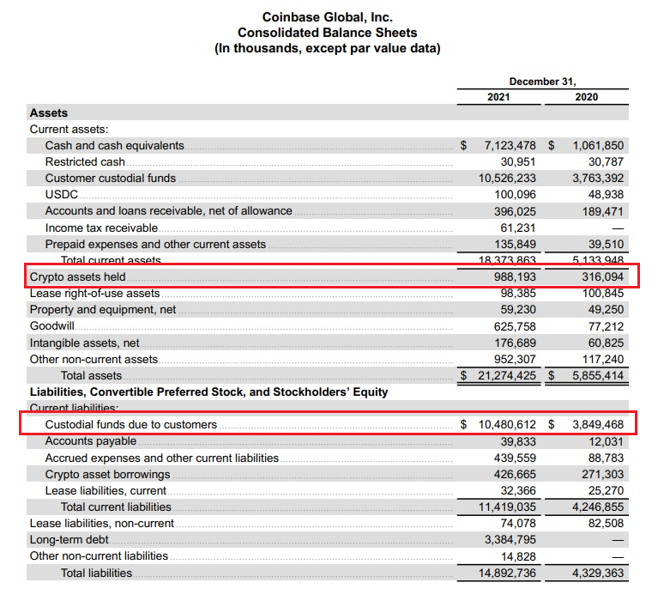
Audit of Financial Statement
Proof of reserves is supposed to instill some added trust, but they aren’t complete audits and don’t necessarily provide a full picture of a company’s financials, such as total liabilities (deposits) owed back to clients and other types of debt. Nor do they assess the quality of a crypto exchange’s controls.
Preparing Financial Statement of Exchange would address many of the issues that were noticed in the recent reports on Proof of Reserves:-
Financial position
Liabilities other than customers liabilities
Contingent liabilities
Off-chain assets or real world assets
Funds borrowed to boost Proof of Reserves
33
4/28/2023
56th World Continuous Auditing & Reporting Symposium

Slide 34
Verification of On-chain Assets
Coin
Public Address
1INCH
0x4cD3aa96836c133c9B9f27daFa7baF744D57404d
Quarter 1 KRs
ATOM
0xceAE7673553c90d0a3cd1A494dA35eDe63910cBF
AVAX
0xD4997FF5b5DAA7638E9f20857c4D563BFBC97B18
AXS
0x758E2c2D1a362E2B3e613545e48285b03581EF43
BTC
1Jmih4f2hMT5b1dmKzTmbhngiUYq41F3hD
34
4/28/2023
56th World Continuous Auditing & Reporting Symposium

Slide 35
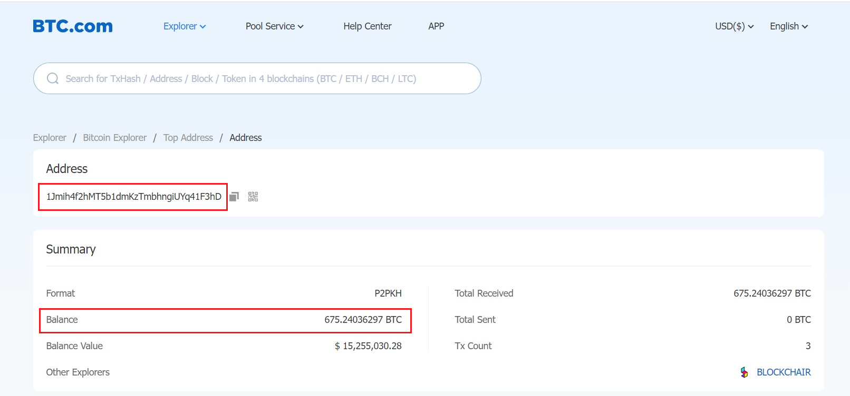
Wallet
35
4/28/2023
56th World Continuous Auditing & Reporting Symposium

Slide 36

Exclusive Control of Private Keys
One way to verify if the holder of crypto coins has exclusive control over Private Key is to ask the holder to sign a message using their Private Key. The holder can then provide the signed message, along with the public address associated with the Private Key, to a third party for verification. If the signature is valid and corresponds to the public address , it is likely that the holder has exclusive control over the Private Key.
It is important to note that a person can prove his control over the Private Key but it doesn’t mean that person is the true owner of the private key.
36
4/28/2023
56th World Continuous Auditing & Reporting Symposium

Slide 37
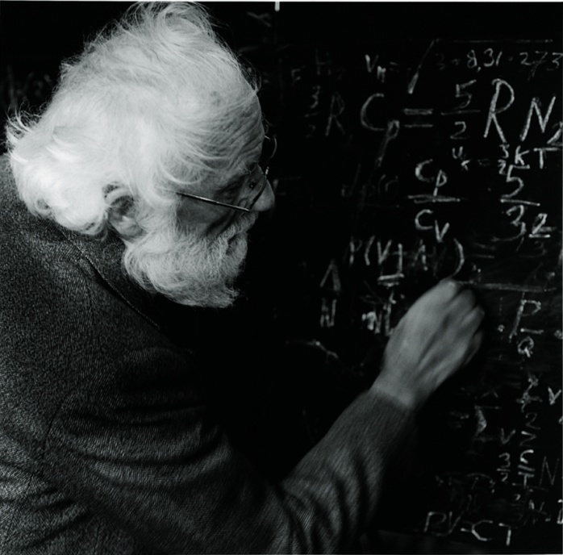
Questions
“No matter how complex things are, basically everything is simple”.

Slide 38

THANK YOU

Slide 39


Vinod Kashyap
Email : vinod@ngdb.ai

